Slide 1

CE101 Engineering Drawing Lec1: Introduction and Basics Part-2: Dimensioning and Scales
Indian Institute of Technology Guwahati
Notes:
Today we will discuss about the Modeling and

Slide 3
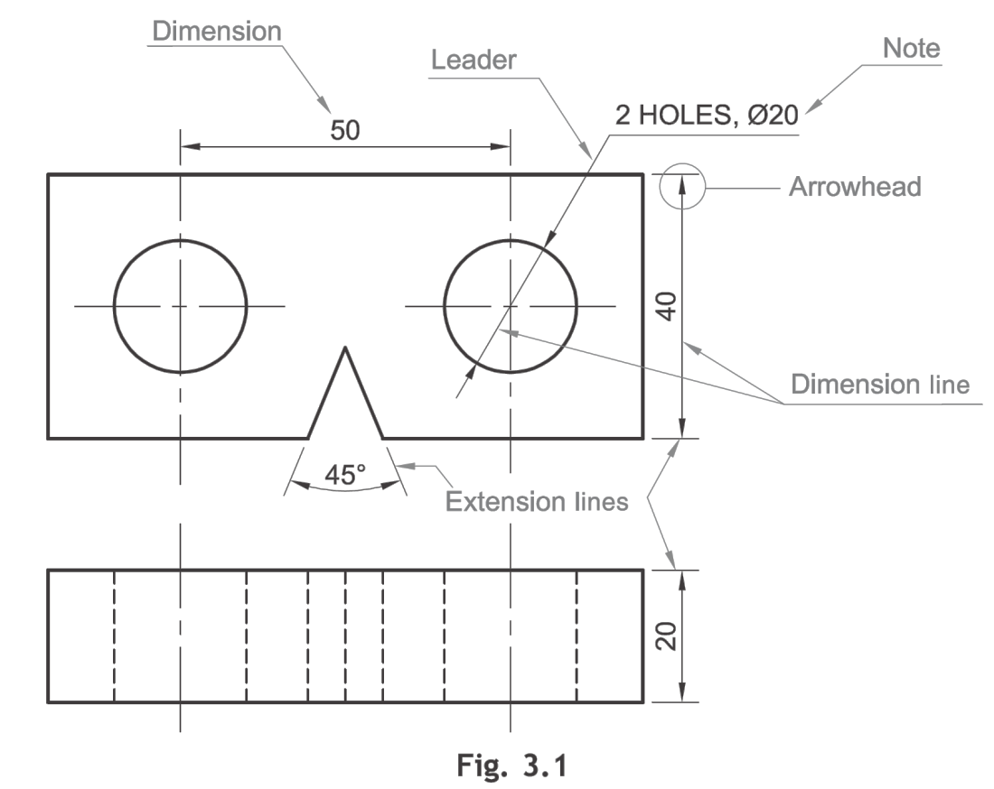
Dimensioning
Dimension is a numerical value expressed in appropriate units of measurement and indicated graphically on technical drawings with lines, symbols and notes (BIS SP 46: 2003)
Dimensioning is done by a set of extension lines, dimension lines, leader lines, arrow heads and dimensions
Symbol for diameter
Unit of length mostly in millimeter
Angles in degrees
Symbols to indicate specific geometry

Slide 4
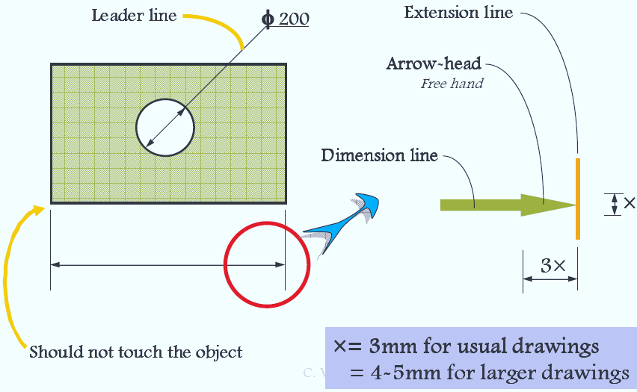
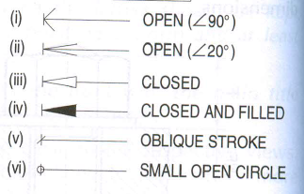
Dimension line: Dimension line is a thin continuous line. It is terminated by arrowheads touching the outlines, extension lines or centre lines
Extension lines: An extension line is also a thin continuous line drawn in extension of on outline. It extends by about 3 mm beyond the dimension line
Arrowheads: An arrowhead is placed at each end of a dimension line. Its pointed end touches an outline, an extension line or a center line. The size of an arrowhead should be proportional to the thickness of the outlines. The length of the arrowhead should be about three times its maximum width
Leader: A leader or a pointer is a thin continuous line connecting a note or a dimension figure with the feature to which it applies.

Slide 5
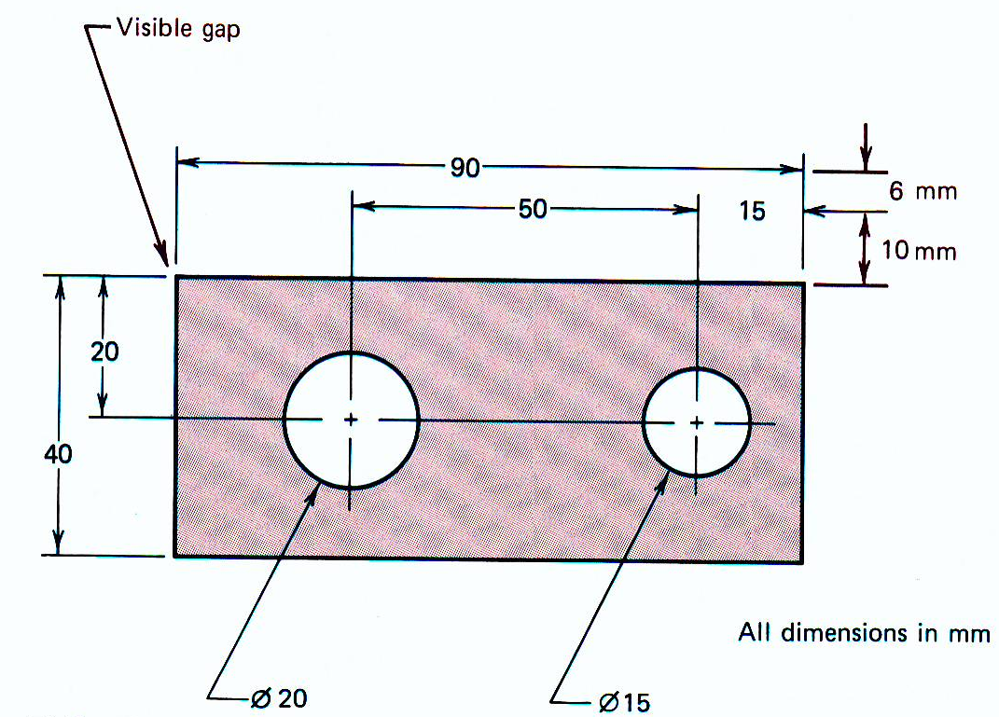
Dimension lines should be drawn at least 10 mm away from the outlines
Smaller dimensions should be placed near the view and the larger away so that extension lines do not cross dimension lines
As far as possible, all the dimensions should be placed outside the views.
Inside dimensions are preferred only if they are clear and easily readable (Avoided)

Slide 7
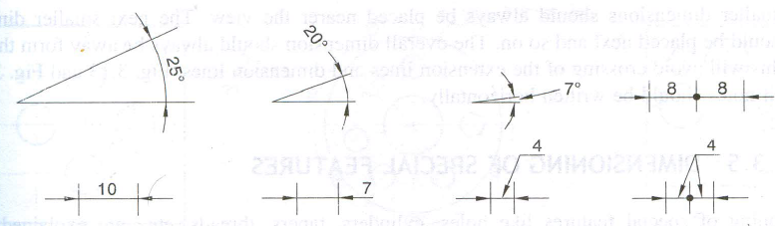
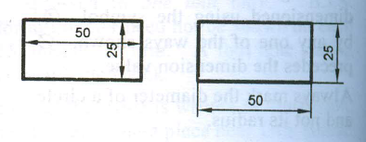
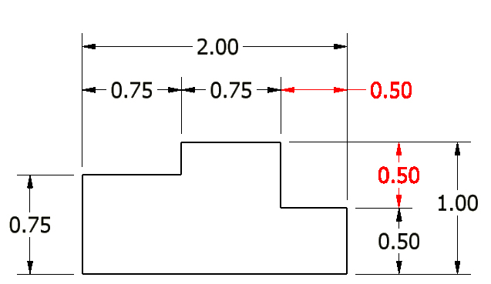
Arrowheads should be drawn within the limits of the dimensioned feature.
When the space is too narrow, they may be placed outside
Dimensions should be placed outside the views
Each dimension should be given only once. No dimension should be redundant
.

Slide 8
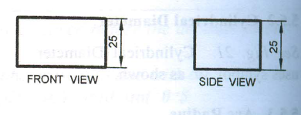
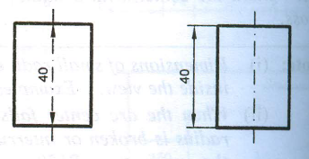
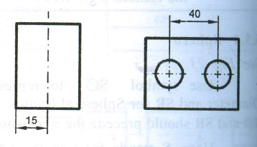
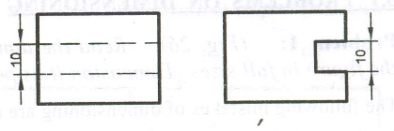
Do not repeat the same dimension in different views
Center line (axis) itself should not be used as a dimension line with arrowheads at its ends
Center line(axis) itself shall not be used as a dimension line with arrowheads as its ends
Dimensions shall be given to visible lines and not to hidden lines

Slide 9
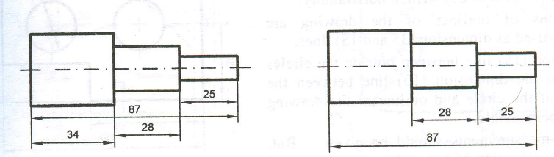
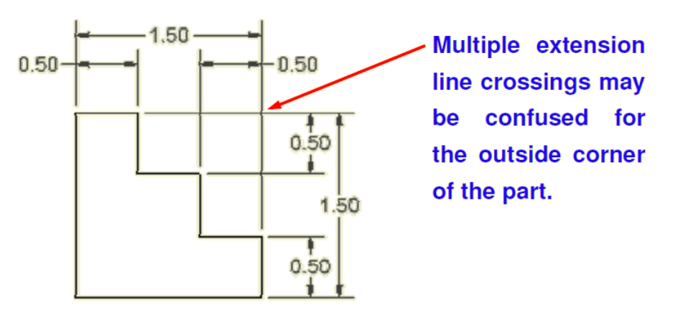
Overall dimension shall be placed outside the intermediate dimensions, i.e. smaller dimensions shall be placed nearer the view and the larger farther away so that extension lines do not cross dimension lines

Slide 11
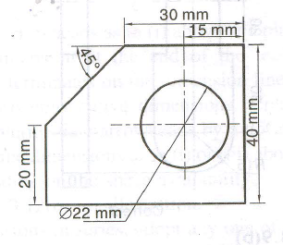
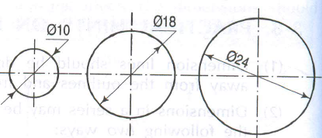
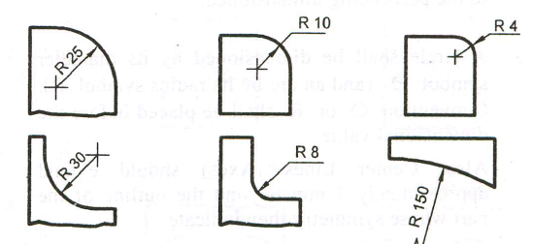
The unit should not be written after each dimension, but a note mentioning the unit should be placed below the drawing.
Circle should be dimensioned by its diameter. The dimensioning should be preceded by the symbol φ
Figure shows various methods of dimensioning different sizes of circles
Arc Radius: An arc is dimensioned by its radius R by any one of the ways. Only one arrowhead with its point on the arc end of the dimension line is used
Dimension line of a radius should pass thorough the center of the arc. Mark the center with a small cross

Slide 12
Spherical radius

Slide 13
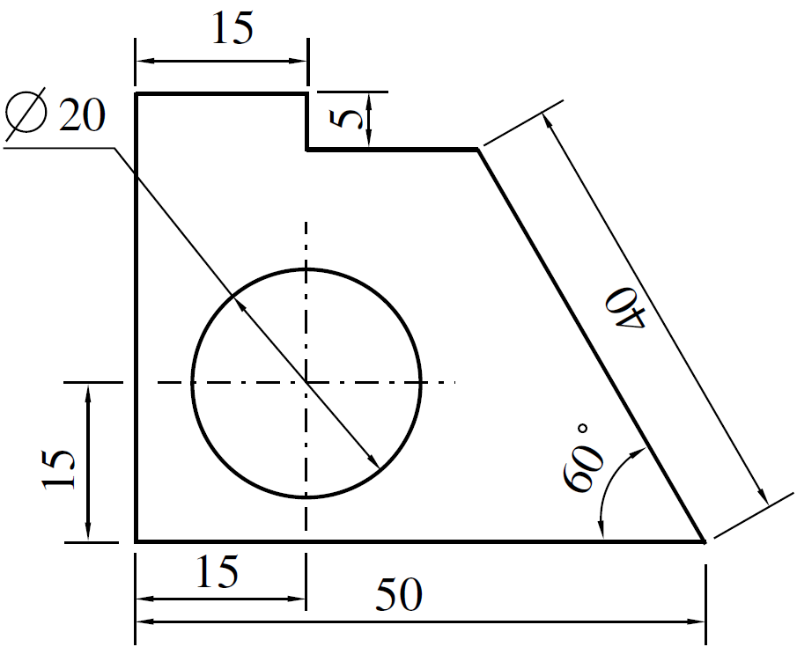
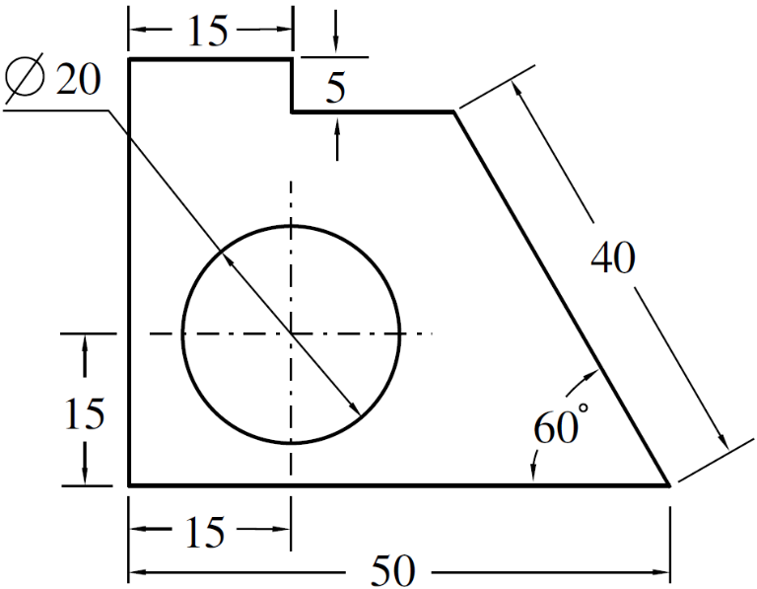
All the dimensions on a drawing must be shown using either Aligned System or Unidirectional System. In no case should, the two systems be mixed on the same drawing.
Aligned System: Dimensions are placed perpendicular to the dimension line so that they may be read from the bottom or right-hand side of the drawing sheet. Dimensions are placed at the middle and above of the dimension lines.
Unidirectional System: Dimensions are placed in such a way that they can be read from the bottom edge of the drawing sheet. Dimension lines are broken near the middle for inserting the dimensions. (PREFERRED)

Slide 15
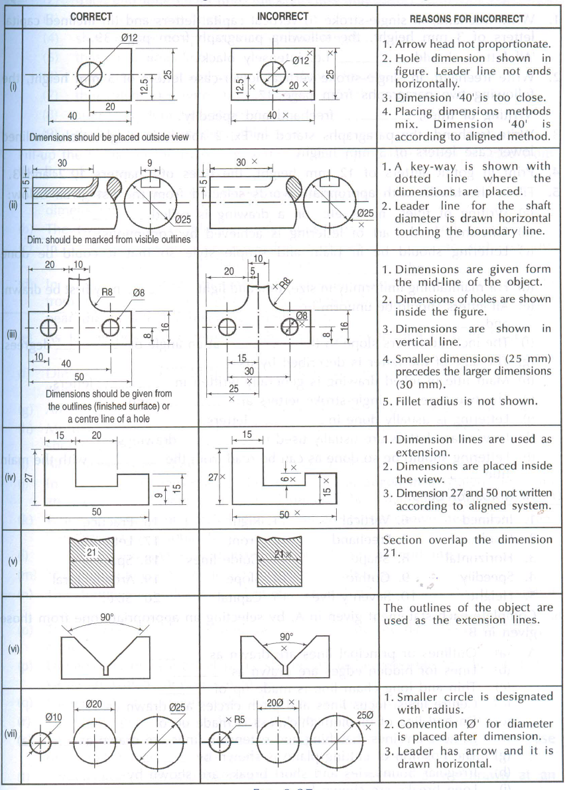
Notes:
An extension line can be used for a centre line but they cannot be used for hidden lines

Slide 18
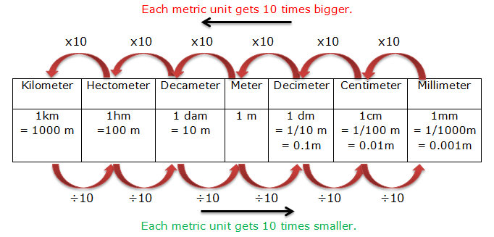
Metric Units

Slide 19
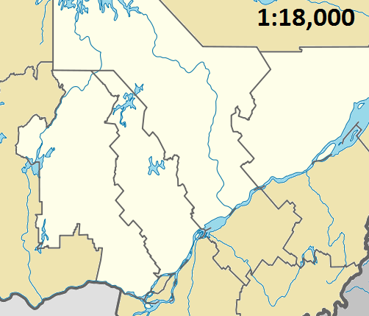
SCALES
The proportion by which the drawing of a given object is enlarged or reduced is called the scale of the drawing.
The scale of a drawing is indicated by a ratio, called the Representative Fraction (RF) or Scale Factor. RF is a ratio of the length of an object on a drawing to the actual length of the object.
Representative Fraction (R.F.)= (Length on drawing)/(Actual length)
The terms ‘scale’ and ‘RF’ are synonymous
Commonly expressed in the format X :Y
FOR FULL SIZE SCALE
R.F.=1 OR ( 1:1 )
MEANS DRAWING
& OBJECT ARE OF
SAME SIZE.
Other RFs are described
as
1:10, 1:100,
1:1000, 1:1,00,000

Slide 20
Enlarging or Enlargement Scales
When smaller objects are to be drawn, they often need to be enlarged
Length of an object on the drawing > actual length of the object.
Enlarging scales are mentioned in the format X : 1, where X > 1; RF > 1
Applications :
Screws and gears used in small electronic gadgets, wristwatch parts, resistors, transistors, ICs.
Reducing or Reduction Scales
Length of the object on the drawing < actual length of the object.
Reducing scales are mentioned in the format 1 :Y, where Y > 1; RF < 1
Applications : multi-storeyed buildings, bridges, huge machinery, ships etc.
i.e., Tiny objects dimensions must be increased, Hence this scale is called ENLARGING SCALE.
Dimensions of large objects must be reduced to accommodate on standard size drawing sheet. This reduction creates a scale of that reduction ratio, which is generally a fraction.
Such a scale is called REDUCING SCALE.

Slide 21
SCALES
BE FAMILIAR WITH THESE UNITS.
1 KILOMETRE
1 HECTOMETRE
1 DECAMETRE
1 METRE
1 DECIMETRE
1 CENTIMETRE
= 10 HECTOMETRES
= 10 DECAMETRES
= 10 METRES
= 10 DECIMETRES
= 10 CENTIMETRES
= 10 MILLIMETRES
USE FOLLOWING FORMULAS FOR THE CALCULATIONS IN THIS TOPIC.
A
DIMENSION OF DRAWING
REPRESENTATIVE FACTOR (R.F.) =
DIMENSION OF OBJECT
=
LENGTH OF DRAWING
ACTUAL LENGTH
=
AREA OF DRAWING
V
ACTUAL AREA
=
VOLUME AS PER DRWG.
3
ACTUAL VOLUME
V
B
LENGTH OF SCALE = R.F. X MAX. LENGTH TO BE MEASURED

Slide 22
Scales commonly used by engineers
Plain Scales
Used to read lengths in two units or to read to first decimal accuracy
Vernier Scales
Used to measure small divisions up to three units or to read to two decimal accuracy
Diagonal Scales
Used to measure in three units such as dm, cm and mm
Construction of scales : General procedure
All the above scales are constructed by drawing a line of length equivalent to the actual distance to be represented.
This length is called length of scale (LOS).
LOS is calculated by the formula
LOS = RF X Maximum distance to be represented
LOS is usually calculated in terms of millimetre.
If the maximum distance to be represented is not known, it may be taken equal to the maximum measurement (rounded off to the higher whole number) to be made with the help of the scale.

Slide 23
Different types of problems
A room of 1000 m³ volume is represented by a block of 125 cm³ volume. Find the R.F and construct a plain scale to measure up to 30 m
cm³ represents 1000 m³,
i.e., 5 cm represents 10 m, R.F. = 5/1000
LOS = RF x 30 x 100 cm = 15 cm
Construct a vernier scale of least count (LC) 2 mm. The LOS is 20 cm. Show the following distance on it 13.4 cm and 2.8 cm
Draw a full size diagonal scale to show 0.1 mm and long enough to measure up to 5 cm. Show on this scale the following distance. (a) 0.1 mm (b) 2.35 cm and (c) 4.89 cm

Slide 24
PLAIN SCALE:-
This type of scale represents two units or a unit and it’s sub-division
PROBLEM NO.1:- Draw a scale 1 cm = 1m to read decimeters, to measure maximum distance of 6 m.
Show on it a distance of 4 m and 6 dm.
CONSTRUCTION:-
a) Calculate R.F.=
R.F.= 1cm/ 1m = 1/100
Length of scale = R.F. X max. distance
= 1/100 X 600 cm
= 6 cm
b) Draw a line 6 cm long and divide it in 6 equal parts. Each part will represent larger division unit.
c) Sub divide the first part which will represent second unit or fraction of first unit.
d) Place ( 0 ) at the end of first unit. Number the units on right side of Zero and subdivisions
on left-hand side of Zero. Take height of scale 5 to 10 mm for getting a look of scale.
e) After construction of scale mention it’s RF and name of scale as shown.
f) Show the distance 4 m 6 dm on it as shown.
DIMENSION OF DRAWING
DIMENSION OF OBJECT
PLAIN SCALE
4 m 6 dm
10
0
1
2
3
4
5
METERS
DECIMETERS
R.F. = 1/100
PLAIN SCALE SHOWING METERS AND DECIMETERS.

Slide 25
36 m
10
5
0
10
20
30
40
METERS
125 mm
Construct a plain scale to show meters when 1 centimeter represents 4 meters and long enough to measure upto 50 meters. Find the R.F and mark on your scale a distance of 36 meters
Length of the scale LOS = RF x Maximum distance to be measured

Slide 26
PROBLEM NO.2:- In a map, a 36 km distance is shown by a line 45 cms long. Calculate the R.F. and construct
a plain scale to read kilometers and hectometers, for max. 12 km. Show a distance of 8.3 km on it.
CONSTRUCTION:-
a) Calculate R.F.
R.F.= 45 cm/ 36 km = 45/ (36 x 1000 x 100) = 1/ 80,000
Length of scale = R.F. X max. distance
= 1/ 80000 X 12 km
= 15 cm
b) Draw a line 15 cm long and divide it in 12 equal parts. Each part will represent larger division unit.
c) Sub divide the first part which will represent second unit or fraction of first unit.
d) Place ( 0 ) at the end of first unit. Number the units on right side of Zero and subdivisions
on left-hand side of Zero. Take height of scale 5 to 10 mm for getting a look of scale.
e) After construction of scale mention it’s RF and name of scale as shown.
f) Show the distance 8.3 km on it as shown.
PLAIN SCALE
8km 3hm
10
5
0
1
2
3
4
5
6
7
8
9
10
11
KILOMETERS
HECTOMETERS
R.F. = 1/80,000
PLANE SCALE SHOWING KILOMETERS AND HECTOMETERS

Slide 27
Vernier Scales
To indicate distance in a unit and its immediate two subdivisions, e.g., m, dm, cm.
It consists of two parts
a primary scale and a vernier
The primary scale is a plain scale fully divided into minor divisions
As it would be difficult to sub-divide the minor divisions in ordinary way, it is done with the help of the vernier.
The graduations on vernier are derived from those on the primary scale.
Unlike plain scale, main scale units are divided into equal parts
Vernier scale is constructed above main scale and it is divided into equal parts as that of main scale.
Length may be more or less by a fixed amount than that of a main division
Division on main scale is referred as main scale divisions (MSD)
Divisions on vernier scale is referred as vernier scale divisions (VSD)
Least count (LC): Minimum length that can be measured by vernier scale.

Slide 28
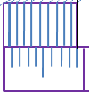
Vernier Scales
The lower scale A0 is the plain scale and the upper scale B0 is the vernier.
The combination of plain scale and the vernier is the vernier scale.
A plain scale in which length A-O represents 10 cm.
Divide A-O into ten equal parts, each will be of 1 cm.
It would not be easy to divide each of these parts into ten equal divisions to get measurements in millimeters
9.9
7.7
5.5
3.3
1.1
0
B
A
9
8
7
6
5
4
3
2
1
0
Backward vernier scale
Take a length BO equal to 10 + 1 = 11 such equal parts, thus representing 11 cm, and divide it into ten equal divisions, each of these divisions will represent 11 / 10 = 1.1 cm.
The difference between one part of AO and one division of BO will be equal 1.1 – 1.0 = 0.1 cm or 1 mm.
Forward vernier scale
Take a length BO equal to 10 - 1 = 9 such equal parts, thus representing 9 cm, and divide it into ten equal divisions, each of these divisions will represent 9 / 10 = 0.9 cm.
The difference between one part of AO and one division of BO will be equal 1.0 – 0.9 = 0.1 cm or 1 mm.
Least count (LC): Minimum length that can be measured by vernier scale.
LC = MSD – VSD (MSD > VSD) Forward vernier scale
LC = VSD – MSD (VSD > MSD) Backward vernier scale

Slide 29
Problem No. 3: The actual length of 300 m of an auditorium is represented by a line of 10 cm on a drawing. Draw a vernier to read upto 600 m and mark a length of 364 m on it.
RF = 10 cm / (300 x 100) cm = 1/3000
LOS = 600 x 100 x RF = 20 cm
Divide scale in 6 equal parts. Each division will represent 100 m.
Divide each division in 10 subdivisions such that 1 sub-division = 10 m, ie, MSD = 10 m.
10 VSD = 9 MSD => each sub-division on VSD = 9/10 MSD = 0.9 MSD
Least count (LC) = MSD-VSD => 0.1 MSD = 1 m
Using forward vernier scale, length = 54 (VSD) + 310 (MSD)
364
Forward Vernier
0
45
90
0
50
100
200
300
400
500
600
Meters
LOS=20cm

Slide 30
Backward/Retrograde Vernier: VSD > MSD and LC = VSD - MSD
MSD = 10 m
10 VSD = 11 MSD => each sub-division on VSD = 11/10 MSD = 1.1 MSD
LC = VSD-MSD = 0.1 MSD = 1m
Using backward vernier scale, length = 44 (VSD) + 320 (MSD)
364
110
55
0
100
50
0
100
200
300
400
500
Meters
LOS=20cm

Slide 31
Example
Draw a vernier scale of RF = 1 / 25 to read centimeters upto
4 meters and on it, show lengths 2.39 m and 0.91 m
Vernier Scale
SOLUTION:
Length of scale = RF X max. Distance
= 1 / 25 X 4 X 100
= 16 cm
CONSTRUCTION: ( Main scale)
Draw a line 16 cm long.
Divide it in 4 equal parts.
( each will represent meter )
Sub-divide each part in 10 equal parts.
( each will represent decimeter )
Name those properly.
CONSTRUCTION: ( vernier)
Take 11 parts of Dm length and divide it in 10 equal parts.
Each will show 0.11 m or 1.1 dm or 11 cm and construct a rectangle
Covering these parts of vernier.
TO MEASURE GIVEN LENGTHS:
(1) For 2.39 m : Subtract 0.99 from 2.39 i.e. 2.39 - 0.99 = 1.4 m
The distance between 0.99 ( left of Zero) and 1.4 (right of Zero) is 2.39 m
(2) For 0.91 m : Subtract 0.11 from 0.91 i.e. 0.91 – 0.11 = 0.80 m
The distance between 0.11 (left side of zero) and 0.80 (right side of zero) is 0.91 m
2.39 m
0.91 m
1.1
.99
.77
.55
.33
.11
0
1.0
.9
.8
.7
.6
.5
.4
.3
.2
.1
0
1
1.4
2
3
METERS
METERS

Slide 32
Example A map of size 500 cm x 50 cm wide represents an area of 6250 sq.Kms.
Construct a vernier scale to measure kilometers, hectometers and decameters
and long enough to measure up to 7 km. Indicate on it a) 5.33 km b) 59 decameters.
Vernier Scale
SOLUTION:
RF =
=
= 2 / 10⁵
Length of
scale = RF X max. Distance
= 2 / 10⁵ X 7 kms
= 14 cm
CONSTRUCTION: ( Main scale)
Draw a line 14 cm long.
Divide it in 7 equal parts.
( each will represent km )
Sub-divide each part in 10 equal parts.
( each will represent hectometer )
Name those properly.
TO MEASURE GIVEN LENGTHS:
a) For 5.33 km :
Subtract 0.33 from 5.33
i.e. 5.33 - 0.33 = 5.00
The distance between 33 dm
( left of Zero) and
5.00 (right of Zero) is 5.33 k m
(b) For 59 dm :
Subtract 0.99 from 0.59
i.e. 0.59 – 0.99 = - 0.4 km
( - ve sign means left of Zero)
The distance between 99 dm and
- 0.4 km is 59 dm
(both left side of zero)
AREA OF DRAWING
V
ACTUAL AREA
500 X 50 cm sq.
V
6250 km sq.
CONSTRUCTION: ( vernier)
Take 11 parts of hectometer part length
and divide it in 10 equal parts.
Each will show 1.1 hm or 11 dm and
covering in a rectangle complete scale.
59 dm
5.33 km
Decameters
99
77
55
33
11
9
7
5
3
1
10
0
1
2
3
4
5
6
HECTOMETERS
KILOMETERS
Notes:
For forward Vernier always use (if l is the length to be measured on the Vernier scale)
L = 9x + 10y
For backward ;
Use
L = 11x + 10y

Slide 33
DIAGONAL SCALE
The diagonal scales give us three successive dimensions that is a unit, a sub-unit and a subdivision of a sub-unit.
Principle of Diagonal Scale: The construction of a diagonal scale is based on the principle of similarity of triangles.
Let the XY in figure be a subunit
From Y draw a perpendicular YZ to a suitable height
Join XZ
Divide YZ in to 10 equal parts
Draw parallel lines to XY from all these divisions and number them
Consider two similar triangles XYZ and 7'7Z,
we have 7Z / YZ = 7’7 / XY (each part being one unit)
means 7'7 = 7 / 10 x XY = 0.7 XY
Similarly
1’ – 1 = 0.1 XY
2’ – 2 = 0.2 XY
Thus, it is very clear that, the sides of small triangles, which are parallel to divided lines, become progressively
shorter in length by 0.1 XY.
X
Y
10’
10
9’
9
8’
8
7’
7
6’
6
5’
5
4’
4
3’
3
2’
2
1
1’
Z

Slide 34
5.99
10
9
8
7
6
CENTIMETRES
5
4
3
2
1
10
8
6
4
2
0
1
2
3
4
5
DECIMETRES
METRES
Construct a diagonal scale of RF= 2/125 and LC of 1 cm. Show the lengths of 5.99 m, 3.31 m and 2.7 dm on it
Max length = 6m; LOS = RF x 600 cm = 9.6 cm
5.99 = 5 (5th main division) + 0.9 (9th horizontal division) + 0.09 (9th vertical division)

Slide 35
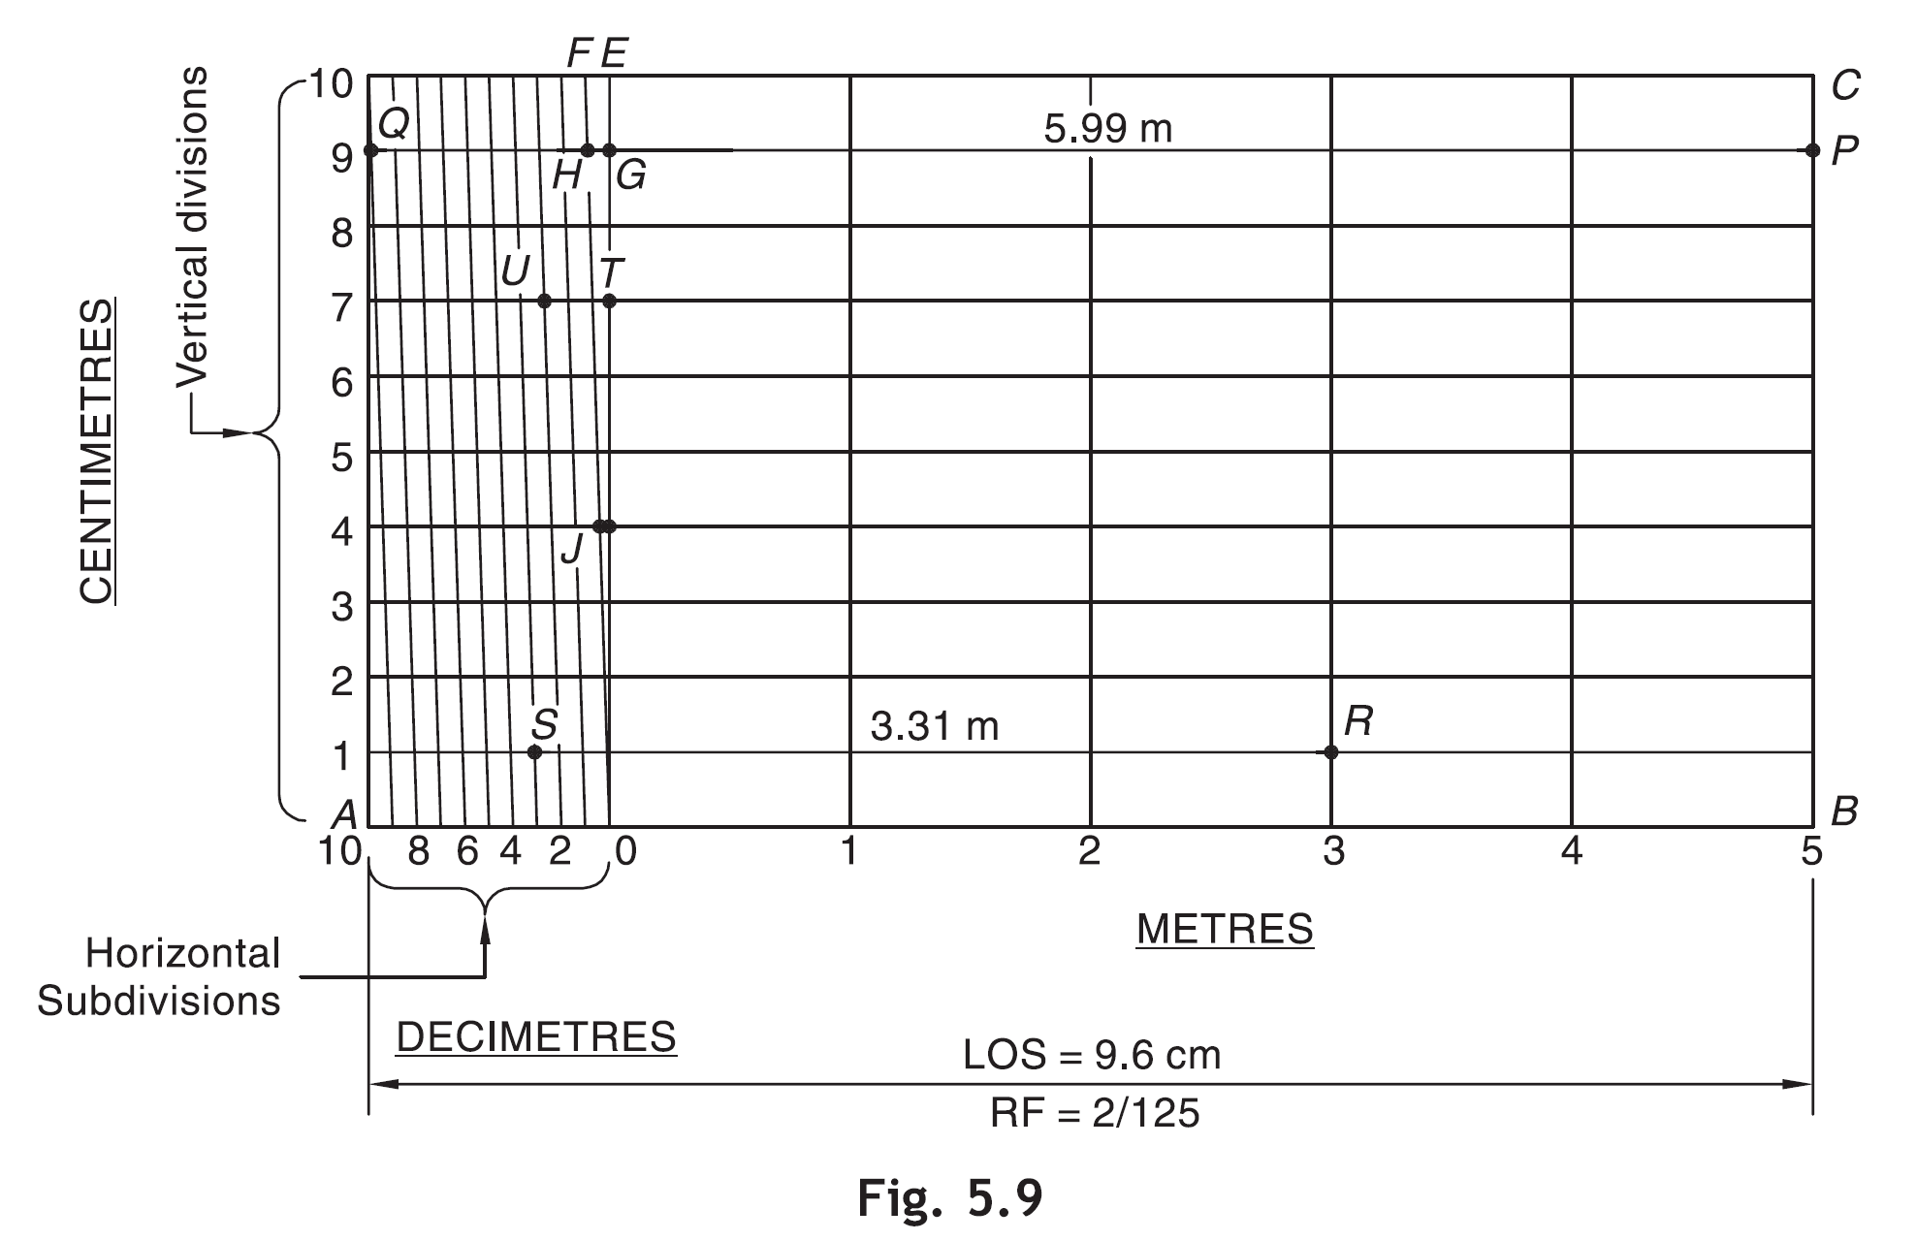

Slide 36
PROBLEM No. 4 : The distance between Delhi and Agra is 200 km.
In a railway map, it is represented by a line 5 cm long. Find it’s R.F.
Draw a diagonal scale to show single km, and maximum 600 km.
Indicate on it following distances. 1) 222 km 2) 336 km 3) 459 km 4) 569 km
DIAGONAL
SCALE
SOLUTION STEPS: RF = 5 cm / 200 km = 1 / 40,00,000
Length of scale = 1 / 40,00,000 x 600 x 10⁵ = 15 cm
Draw a line 15 cm long. It will represent 600 km.Divide it in six equal parts.( each will represent 100 km.)
Divide first division in ten equal parts.Each will represent 10 km.Draw a line upward from left end and
mark 10 parts on it of any distance. Name those parts 0 to 10 as shown.Join 9th sub-division of horizontal scale
with 10th division of the vertical divisions. Then draw parallel lines to this line from remaining sub divisions and
complete diagonal scale.
569 km
459 km
336 km
222 km
10
9
8
7
6
5
4
3
2
1
0
KM
KM
100
50
0
100
200
300
400
500
KM
R.F. = 1 / 40,00,000
DIAGONAL SCALE SHOWING KILOMETERS.

Slide 37
PROBLEM No. 5: A rectangular plot of land measuring 1.28 hectors is represented on a map by a similar rectangle
of 8 sq. cm. Calculate RF of the scale. Draw a diagonal scale to read single meter. Show a distance of 438 m on it.
SOLUTION :
1 hector = 10, 000 sq. meters
1.28 hectors = 1.28 x 10,000 sq. meters
= 1.28 x 10⁴ x 10⁴ sq. cm
8 sq. cm area on map represents
= 1.28 x 10⁴ x 10⁴ sq. cm on land
1 cm sq. on map represents
= 1.28 x 10 ⁴ x 10⁴ / 8 sq cm on land
1 cm on map represent
=
DIAGONAL
SCALE
Draw a line 15 cm long.
It will represent 600 m.Divide it in six equal parts.
( each will represent 100 m.)
Divide first division in ten equal parts.Each will
represent 10 m.
Draw a line upward from left end and
mark 10 parts on it of any distance.
Name those parts 0 to 10 as shown.Join 9th sub-division
of horizontal scale with 10th division of the vertical divisions.
Then draw parallel lines to this line from remaining sub divisions
and complete diagonal scale.
1.28 x 10 ⁴ x 10⁴ / 8
cm
= 4, 000 cm
1 cm on drawing represent 4,000 cm, Means RF = 1 / 4000
Assuming length of scale 15 cm, it will represent 600 m.
438 meters
10
9
8
7
6
5
4
3
2
1
0
M
M
100
50
0
100
200
300
400
500
M
R.F. = 1 / 4000
DIAGONAL SCALE SHOWING METERS.

Slide 38
PROBLEM No. 6:. Draw a diagonal scale of R.F. 1:2.5, showing centimeters
and millimeters and long enough to measure up to 20 centimeters.
SOLUTION STEPS:
R.F. = 1 / 2.5
Length of scale = 1 / 2.5 X 20 cm.
= 8 cm.
1. Draw a line 8 cm long and divide it in to 4 equal parts.
(Each part will represent a length of 5 cm.)
2. Divide the first part into 5 equal divisions.
(Each will show 1 cm.)
3. At the left hand end of the line, draw a vertical line and
on it step-off 10 equal divisions of any length.
4. Complete the scale as explained in previous problems.
Show the distance 13.4 cm on it.
DIAGONAL
SCALE
13 .4 CM
10
9
8
7
6
5
4
3
2
1
0
MM
CM
5
4
3
2
1
0
5
10
15
CENTIMETRES
R.F. = 1 / 2.5
DIAGONAL SCALE SHOWING CENTIMETERS.

Slide 39
Self Study
Please refer to any engineering drawing text book
Dividing line into equal parts
Dividing circle into equal parts
Perpendicular bisection
Angular bisection
Construction of triangles
Construction of regular polygons such as pentagon, hexagon
Inscribed circles
Drawing tangents and normal

Slide 40

Thank You for Patient Hearing

